Slide 1
Legacy Academy
Student Attendance Review Team
(SART)

Slide 2
SART Meeting Purpose
Communication between the school and families
Notification of student(s) attendance
Review of attendance education codes
Provide necessary interventions and resources

Slide 4
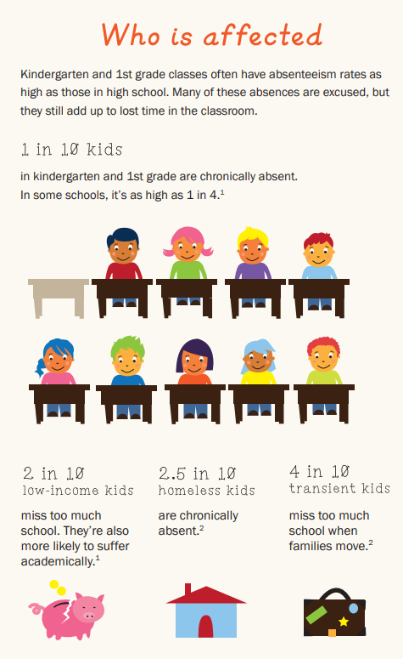
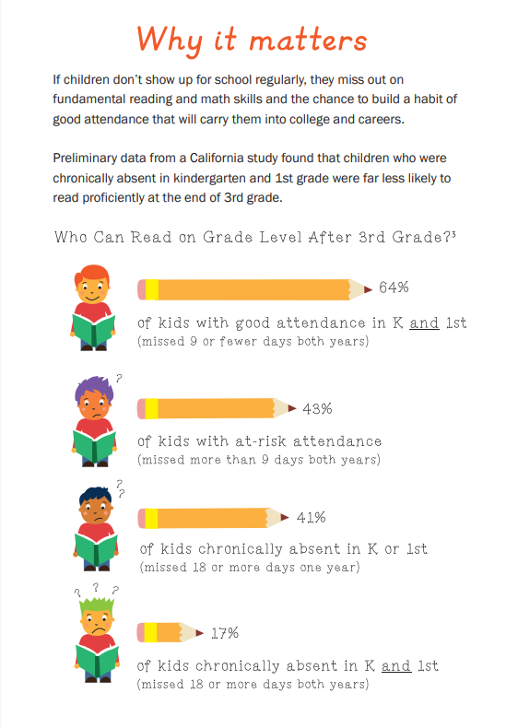

Slide 5
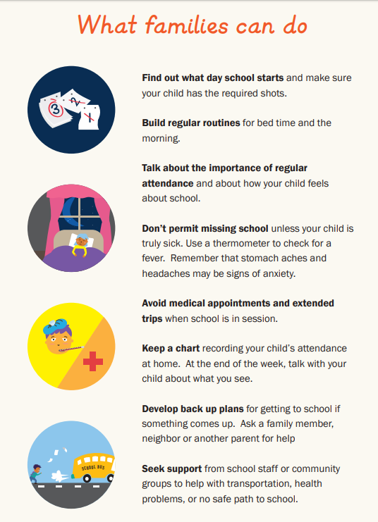

Slide 6
Summary of student’s attendance
Total days enrolled
First Notifications:
When student has 3 unexcused absences - classified as a truant per Ed. Code 48260.5
When student has 10 excused absences
Second Notifications:
When student has 6 unexcused absences - classified as a habitual truant per Ed. Code 48261
When student has 15 excused absences
Conduct a Student Attendance Review Team (SART) Meeting

Slide 7
How to understand your student’s attendance screen or printout…
Tardy eighth period
Absent zero period thru sixth period
Excused absence verified within five days
Absent first and sixth period
CVUSD Absence Codes
A = Absent
C = Campus Emergency
E = Excused
F = Field Trip
G = Saturday Make-up
H = Out of Town
I = Incomplete Indep. Study
J = ALC
K = Excused Late
L = Late, less than 30 min.
M = Late, more than 30 min.
O = Office
P = Present
Q = In-Hospitalization
S = Suspension
T = Truancy
U = Unexcused, parent verified
V = Verified Indep. Study
W = Entertainment Industry Work
X = Testing
Y = TDAP
Z = Administrative Initiated

Slide 8
Why should your student
be in school?
t’s the law
Parent, guardian or other person having control or charge of the pupil shall send the pupil to full-time education between the ages of 6 and 18 (Educational Code 48200)
Any parent/guardian, or other person in charge of any pupil who fails to comply with 48200 is guilty of an infraction and shall be punished (Education Code 48293(a) by court
First Conviction – $250
Second Conviction - $500
Third Conviction - $1,500
Case will be referred to District Attorney’s Office for further prosecution
Penal Code 272 (a)(1) Failure to enroll your student in an educational program could result in:
$2,500 fine
1 year in county jail
Probation (up to 5 years)
VC 13202.7 Any minor under the age of 18 years, but 13 years of age or older who is classified as a habitual truant may have his/her driving privilege suspended for one year.

Slide 9
Types of Absences
Excused – Ed. Code: 48205
Student’s personal illness
Student’s Medical/Dental Appointments
Family Funeral Services
Student’s Court Appearance
You must call in and report an absence within 3 school days
(909) 393-4087
Unexcused
Going to work with parent
Going to the beach
Babysitting or taking care of a family member
Personal problems without admin approval
Missing the bus

Slide 10
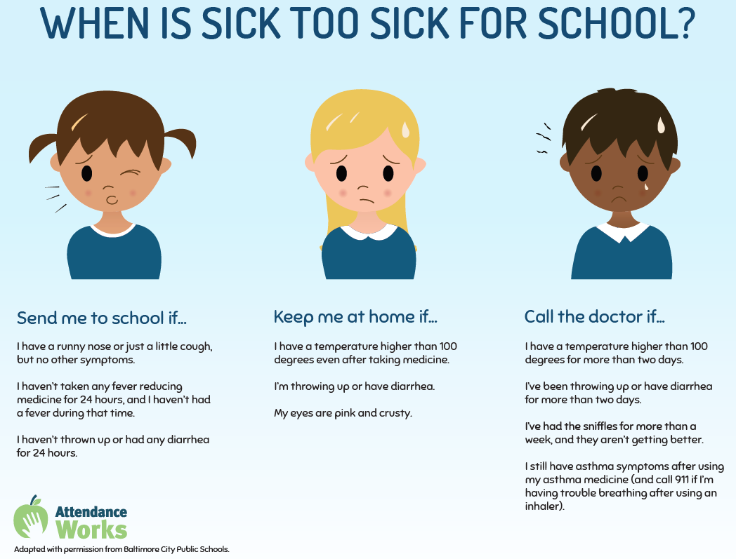

Slide 11
Student Attendance Review Board (SARB) Process
CVUSD recommends that all schools refer students to SARB after the third notification is sent to parents:
Unexcused Absences:
When student accumulates 9 unexcused absences
Excused Absences:
When student has 20 excused absences
CVUSD recommends that all schools refer students to SARB if they violate their SART Contract.

Slide 12
QUESTIONS?
Legacy Academy
Mrs. DeVoe, Assistant Principal (909) 364-2319

